Slide 1
Chemistry (CYL1010) Slot: F (Mon 1 – 1:50, Tue 1- 1:50, Thu 1 – 1:50)
Slot: N (Mon 4 – 4:50, Tue 8- 8:50, Thu 8 – 8:50)
Dr. Rakesh K. Sharma (Email: rks@iitj.ac.in) (Coordinator)
Dr. Samanwita Pal (Email: samanwita@iitj.ac.in)
Dr. Koushambi Mitra (Email: kmitra@iitj.ac.in)
Department of Chemistry, Indian Institute of Technology Jodhpur,
Jodhpur, Rajasthan, India – 342030.

Slide 2
Course Plan
Evaluation Components
Component
Assignments | 10 % (3.33% from each instructors)
Minor | 30% (KM 20% + SP 10%)
Major | 45% (RKM 25% + SP 15% + KM 5%)
Continuous Evaluation | 15 %(Quiz, etc.) (RKM 5%, SP 5%, KM 5%)

Slide 3
Course Content

Slide 4
Course Content to be discussed
Basic Spectroscopy: Selection Rules, Fundamentals FTIR, Raman, UV-visible and Fluorescence spectroscopy, Examples from Organometallic chemistry (7-8 lectures)
Text book:
Banwell, C. N., (2010) Fundamentals of Molecular Spectroscopy, Tata McGraw Hill
Pavia, D. L., et.al., (2015) Introduction to Spectroscopy, Cengage Learning

Slide 5
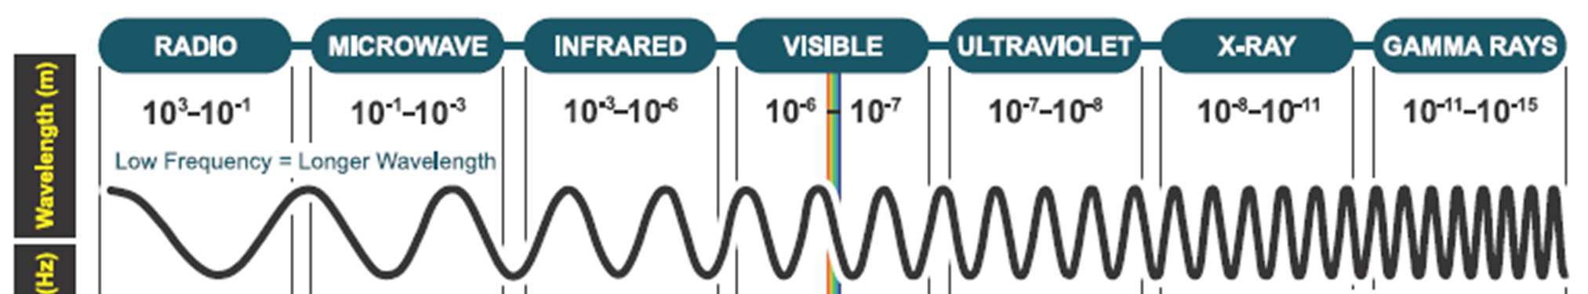
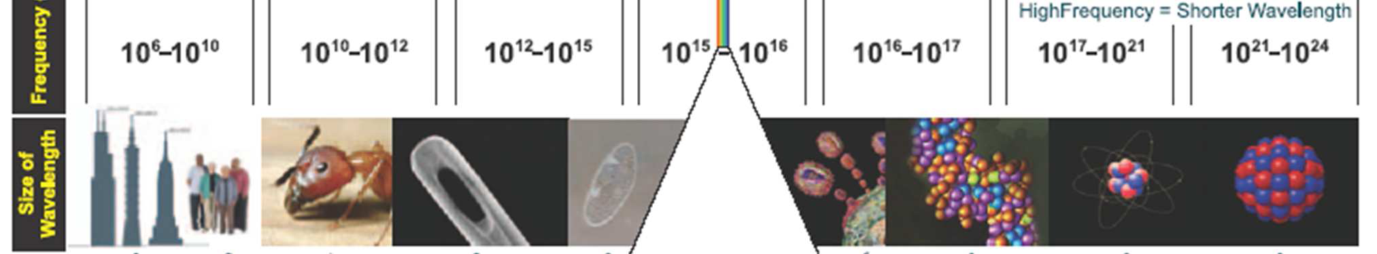
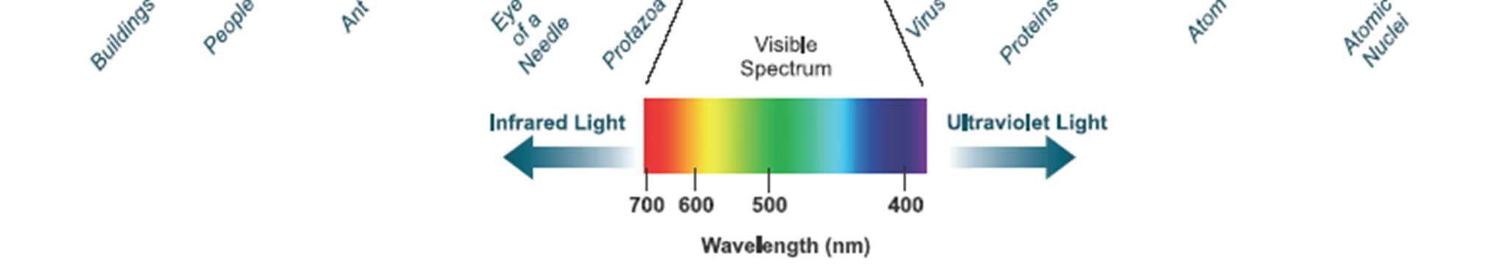
The electromagnetic spectrum
The energy unit

Slide 6
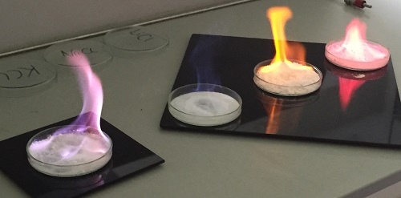
Identification of Elements

Slide 7
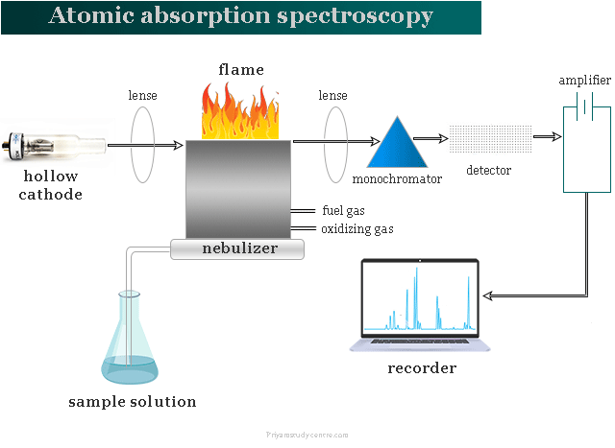

Slide 8
UV-VISIBLE SPECTROSCOPY
-An Introductory lecture

Slide 9
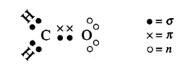
Principle of UV-VISIBLE spectroscopy
Radiation and the molecule - Excitation of electronic transition
Valence electrons – sigma (σ), pi (π) and non-bonded (n) orbitals.
Formation of σ and π orbitals – overlap of two atomic or hybrid orbitals.
What is the hybridization of carbon in formaldehyde?

Slide 10
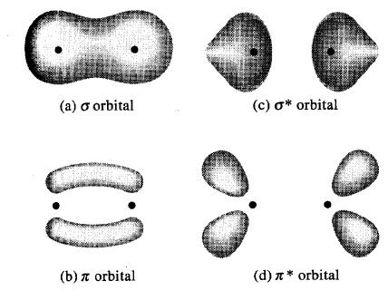
Sigma and pi molecular orbitals
Bonding
Antibonding

Slide 11
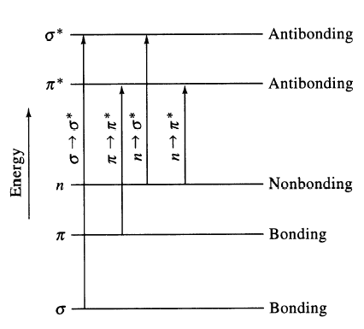
Electronic transitions
n π∗
< 105kcal (>270 nm)
n σ∗
< 150kcal (> 185nm)
π π∗
< 170kcal (> 165nm)
σ σ∗
> 170kcal (< 165nm)
Nuclear coordinates

Slide 12
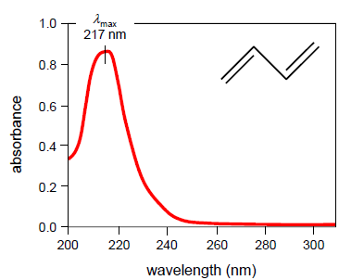
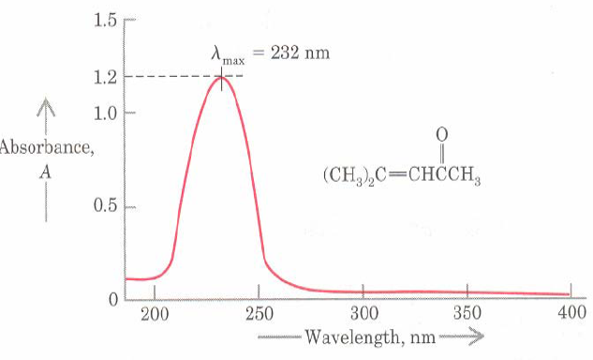
The UV-VIS Spectrum
No visible light absorption
Can we make some critical comment about the spectrum?

Slide 13
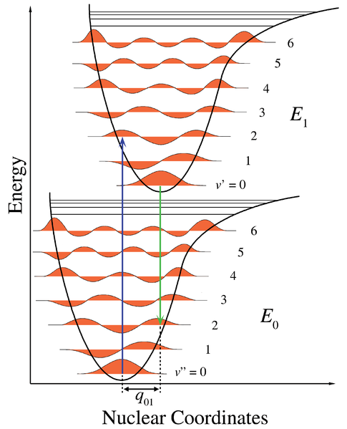
The Franck-Condon Principle

Slide 14
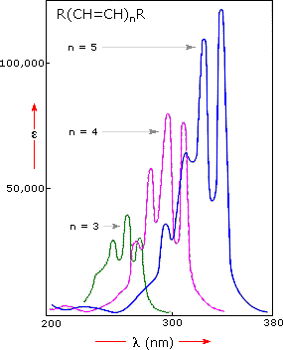
Effect of conjugation
Nature of absorption shift
To longer wavelength | Bathochromic
To shorter wavelength | Hypsochromic
To higher absorbance | Hyperchromic
To lower absorbance | Hypochromic
http://www2.chemistry.msu.edu

Slide 15
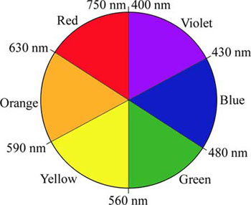
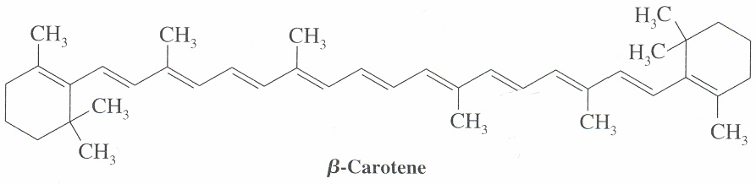
Relation between absorbed light and observed colour
Can you predict λ_{max} ?

Slide 16
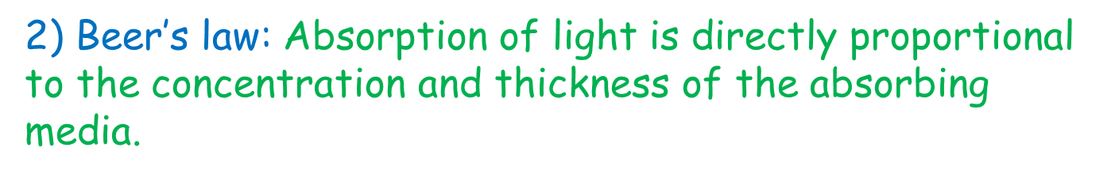
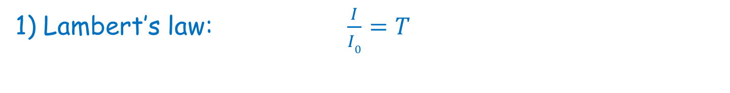
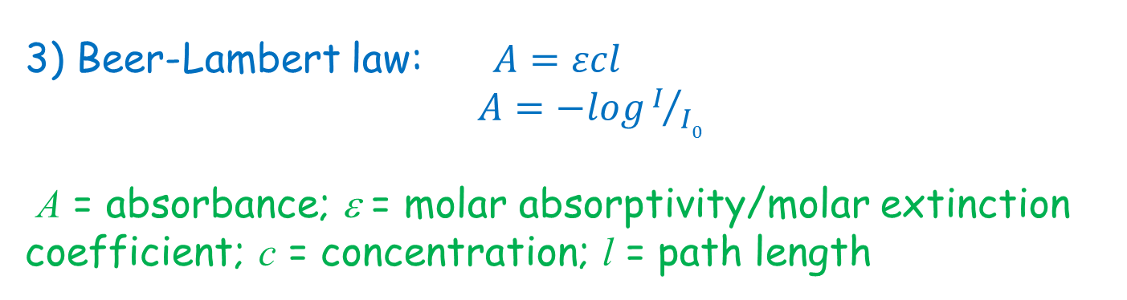
Laws of absorption
1) Lambert’s law: $\frac{I}{I0}=T$
I: Intensity of transmitted light; I₀ : Intensity of incident light
T: Transmittance
2) Beer’s law: Absorption of light is directly proportional to the concentration and thickness of the absorbing media.
3) Beer-Lambert law: $A=εcl$
$A=−logI/{I0}$
A = absorbance; ε = molar absorptivity/molar extinction coefficient; c = concentration; l = path length

